Slide 1
Python Programming Project
Smart Waste Classification System
Classifies waste as biodegradable, recyclable or non-recyclable
Team Members & Roll Numbers
26RH1A05KQ – P. NAVYA TEJASWI
26RH1A05KT – P. GAYATHRI
26RH1A05KR – P. SPANDANA
Department / Section
CSE/ I - SECTION
Faculty Name
Mr. Rajesh Sir

Slide 2
Introduction
1
2
3
Introduction to the Project
Purpose
Importance of the Application
A Python application that sorts waste items into biodegradable, recyclable or non-recyclable using predefined rules.
To help users decide quickly which bin an item belongs in, using simple, rule-based logic.
Correct segregation reduces landfill, improves recycling and supports a cleaner environment.

Slide 3
Problem Statement
Problem Identified
Existing Limitations
Proposed Python Solution
›
›
People often mix wet, dry and recyclable waste because they are unsure how to classify items.
Manual sorting is slow and error-prone; awareness is low and clear guidance is rarely available.
A program that takes an item name and instantly returns its waste category and the correct bin.

Slide 4
Objectives
1
Automate the Required Task
2
Reduce Manual Effort
Classify waste items automatically from user input.
No need to look up or guess disposal rules.
3
Improve Accuracy
4
Easy-to-Use Application
Consistent rules give correct results every time.
Simple menu-driven interface for any user.

Slide 5
Python Concepts Used
Variables & Data Types
Operators
if-elif-else
for / while loops
item, category, count
comparison, membership (in)
rule-based decisions
menu loop, keyword search
Lists / Tuples / Sets / Dictionaries
Functions
Strings
keyword → category map
classify(), show_result()
lower(), strip(), split()

Slide 6
Project Design
Start
→
Input
Waste Item
→
Processing
Match Rules
→
Output
Category + Bin
→
Repeat / Exit
Algorithm
Project Modules
Start the program
Read the waste item from the user
Clean text and search keyword rules
Display category and bin colour
Repeat until the user exits
Input module
Rule / database module
Classification module
Output & history module

Slide 7
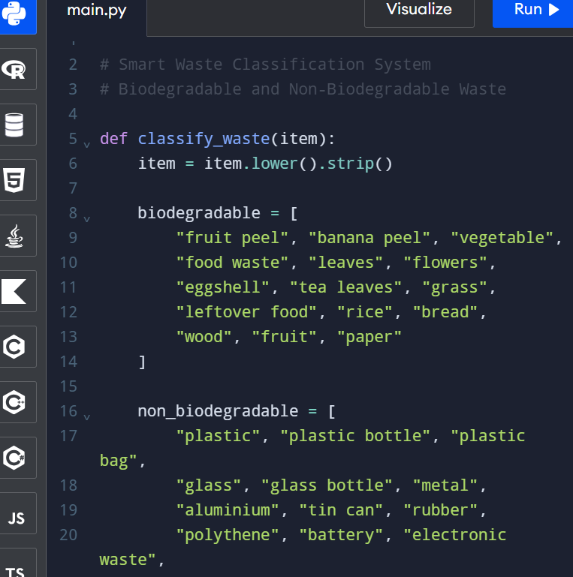
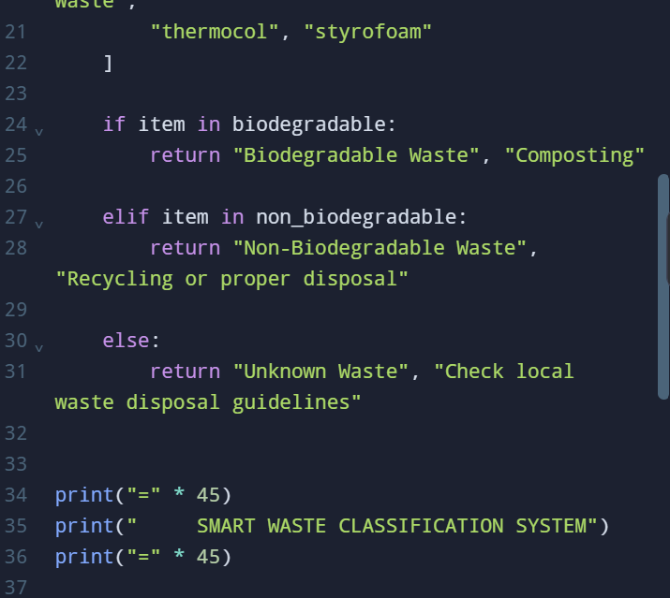
Implementation
# Smart Waste Classification System
# Beginner-friendly Python project (rule-based)
from datetime import datetime # date/time module
# Dictionary: item -> category
waste_db = {
"banana peel": "Biodegradable",
"vegetable": "Biodegradable",
"fruit": "Biodegradable",
"leaves": "Biodegradable",
"newspaper": "Recyclable",
"paper": "Recyclable",
"plastic bottle": "Recyclable",
"glass": "Recyclable",
"metal": "Recyclable",
"chip packet": "Non-recyclable",
"thermocol": "Non-recyclable",
"diaper": "Non-recyclable",
}
# Dictionary: category -> bin colour
bin_colour = {
"Biodegradable": "Green bin",
"Recyclable": "Blue bin",
"Non-recyclable": "Black bin",
}
def classify(item):
"""Return the waste category of an item."""
item = item.lower().strip()
for key in waste_db:
if key in item:
return waste_db[key]
return "Unknown"

Slide 8
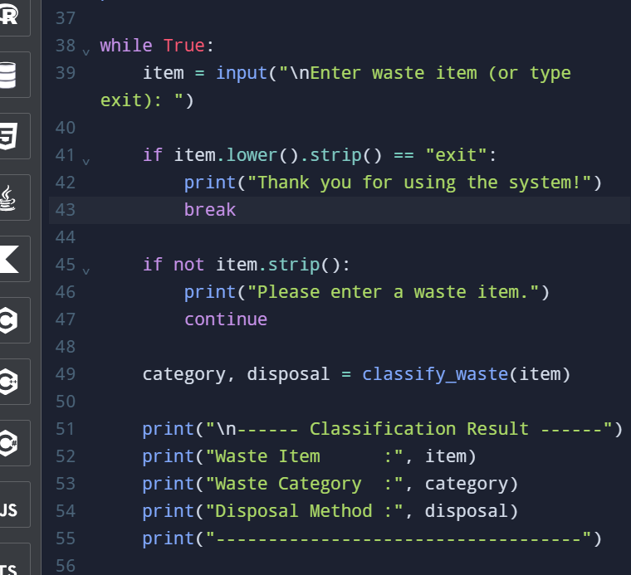
Implementation
def show_result(category):
if category == "Biodegradable":
tip = "Use it for compost."
elif category == "Recyclable":
tip = "Clean it and recycle."
elif category == "Non-recyclable":
tip = "Dispose of it carefully."
else:
tip = "Item not in the list."
print("Category :", category)
if category != "Unknown":
print("Bin :", bin_colour[category])
print("Tip :", tip)
def save_history(item, category):
now = str(datetime.now())[:16]
with open("history.txt", "a") as f:
f.write(now + " | " + item)
f.write(" | " + category + "\n")
def main():
print("=" * 38)
print(" SMART WASTE CLASSIFICATION SYSTEM")
print("=" * 38)
count = 0
while True:
item = input("\nEnter item (or exit): ")
if item.lower().strip() == "exit":
break
if item.strip() == "":
print("Please type something.")
continue
category = classify(item)
show_result(category)
save_history(item, category)
count += 1
print("\nItems checked:", count)
print("Thank you! Keep the city clean.")
main()

Slide 9
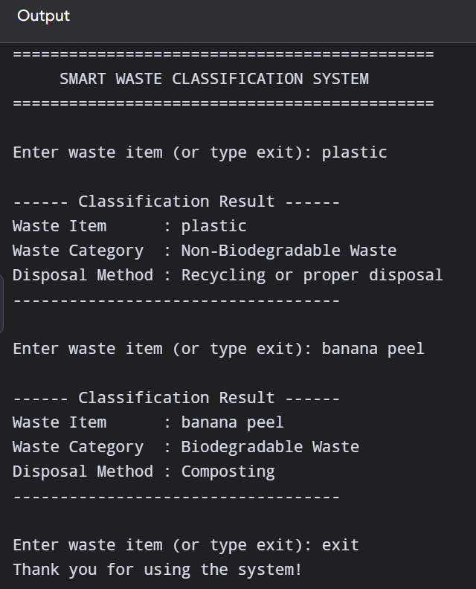
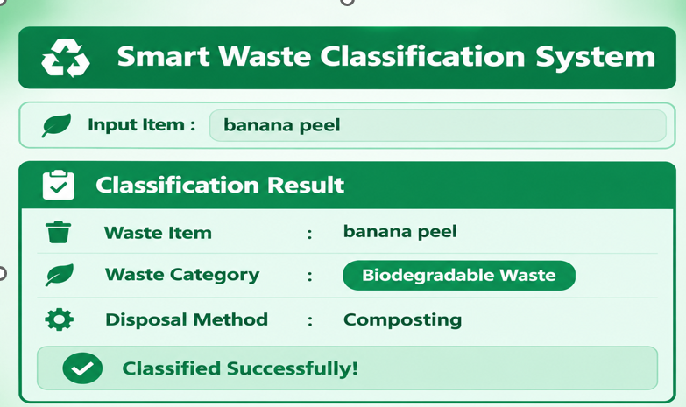
Output / Results
Sample inputs & test cases
Output screenshot (sample)
Input | Expected | Output | Result
banana peel | Biodegradable | Biodegradable | Pass
Plastic Bottle | Recyclable | Recyclable | Pass
chip packet | Non-recyclable | Non-recyclable | Pass
newspaper | Recyclable | Recyclable | Pass
laptop | Unknown | Unknown | Pass
Enter item (or exit): banana peel
Category : Biodegradable
Bin : Green bin
Tip : Use it for compost.
Enter item (or exit): laptop
Category : Unknown
Tip : Item not in the list.
Enter item (or exit): exit
Items checked: 2
Results obtained: all 5 test cases passed; correct bin shown for every known item.

Slide 10
Learning Outcomes
1
Practical application of Python
2
Understanding data structures
3
Function-based programming
4
Debugging and testing
5
Problem-solving and teamwork

Slide 11
Conclusion & Future Scope
Project Achievements
Advantages
Working classifier that gives the right category and bin.
Fast, simple, accurate and easy to extend.
Limitations
Future Enhancements
Limited to stored keywords; no real-time image input.
GUI, database connectivity, web application and advanced features such as image recognition.
Thank You!

